Slide 1
The State of Artificial Intelligence in Design
Why tech civic designers should care about ai
March 2023

Slide 2
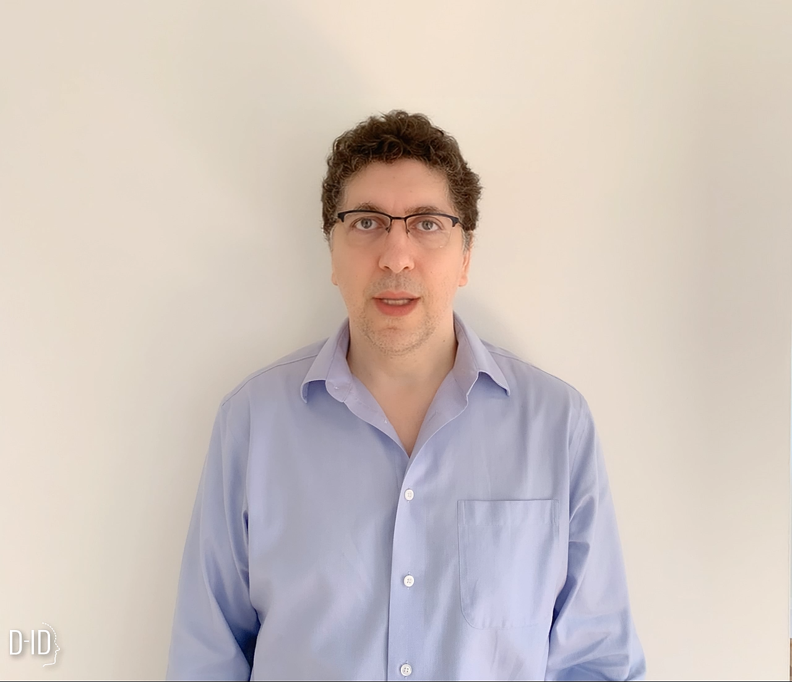

Slide 3
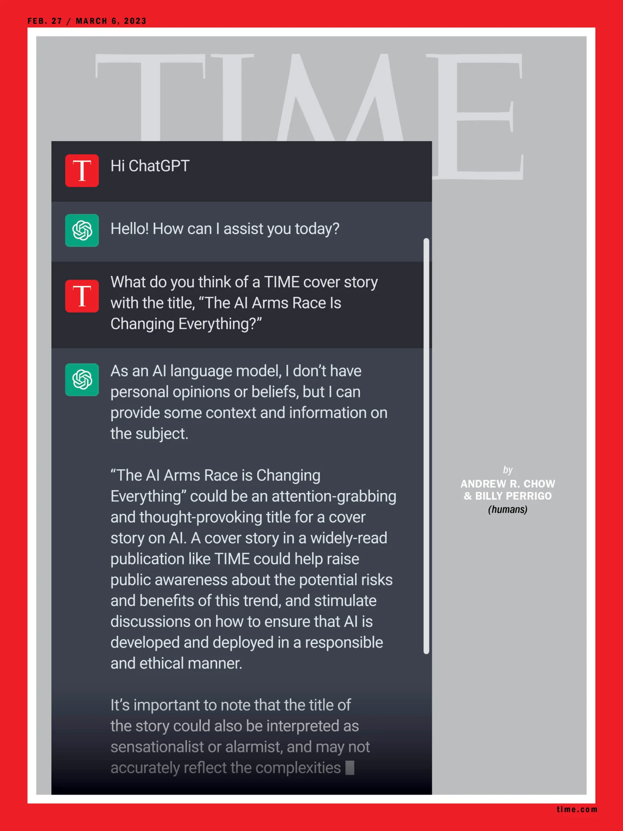

Slide 4
Demystifying ai
AI
ANI
AGI
Artificial narrow intelligence
Artificial general intelligence
E.g. smart speaker, self-driving car, web search, AI in farming and factories
Do anything a human can do

Slide 5
When will we get there?
AGI
Year 2050
Year 2100
~1e29 FLOP*
~1e41 FLOP*
Amount of FLOP done in a human lifetime
Amount of FLOP done over the course of evolution
* Floating point operations per second
Source: Dr. Ajeya Cotra, “Lifetime Anchor hypothesis”, 2020

Slide 6
MACHINE LEARNING
Machine Learning (ML) is a subfield of computer science evolved from the study of pattern recognition and computational learning theory in artificial intelligence.
In 1959, Arthur Samuel defined ML as a “Field of study that gives computers the ability to learn without being explicitly programmed”.

Slide 7
Supervised learning
A
B

Slide 8
Supervised learning
A
B

Slide 9
Supervised learning
A
B
Input
Output

Slide 10
Supervised learning
Input (A)
Output (B)
Application
email
Spam? (0/1)
audio
Text transcript
English
Spanish
Ad, user info
Click? (0/1)
Image, radar info
Position of other cars
Image of product
Defect?

Slide 11
Supervised learning
Input (A)
Output (B)
Application
email
Spam? (0/1)
Spam Filtering
audio
Text transcript
English
Spanish
Ad, user info
Click? (0/1)
Image, radar info
Position of other cars
Image of product
Defect?

Slide 12
Supervised learning
Input (A)
Output (B)
Application
email
Spam? (0/1)
Spam Filtering
audio
Text transcript
Speech recognition
English
Spanish
Ad, user info
Click? (0/1)
Image, radar info
Position of other cars
Image of product
Defect?

Slide 13
Supervised learning
Input (A)
Output (B)
Application
email
Spam? (0/1)
Spam Filtering
audio
Text transcript
Speech recognition
English
Spanish
Machine translation
Ad, user info
Click? (0/1)
Image, radar info
Position of other cars
Image of product
Defect?

Slide 14
Supervised learning
Input (A)
Output (B)
Application
email
Spam? (0/1)
Spam Filtering
audio
Text transcript
Speech recognition
English
Spanish
Machine translation
Ad, user info
Click? (0/1)
Online advertising
Image, radar info
Position of other cars
Image of product
Defect?

Slide 15
Supervised learning
Input (A)
Output (B)
Application
email
Spam? (0/1)
Spam Filtering
audio
Text transcript
Speech recognition
English
Spanish
Machine translation
Ad, user info
Click? (0/1)
Online advertising
Image, radar info
Position of other cars
Self-driving car
Image of product
Defect?

Slide 16
Supervised learning
Input (A)
Output (B)
Application
email
Spam? (0/1)
Spam Filtering
audio
Text transcript
Speech recognition
English
Spanish
Machine translation
Ad, user info
Click? (0/1)
Online advertising
Image, radar info
Position of other cars
Self-driving car
Image of product
Defect?
Visual inspection

Slide 17
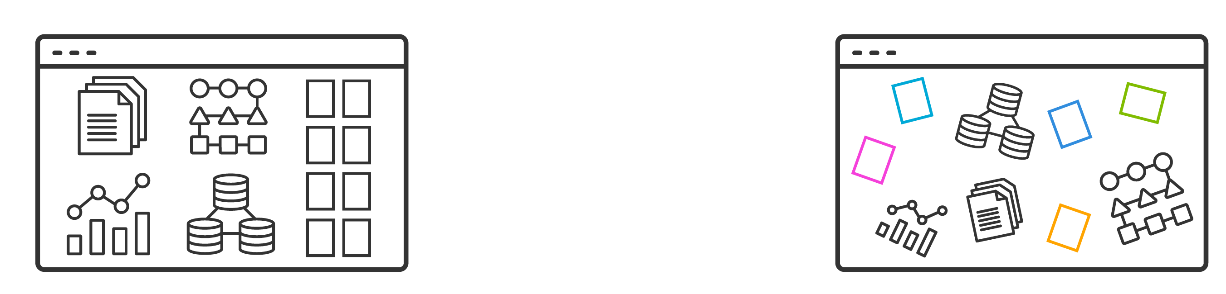
data
Structured Data
Unstructured Data
Spreadsheets
Databases
Conforms to a data model
Fixed fields in a file or record
Web pages
Videos
User comments on social media
Memos

Slide 18
Machine learning
Input commands
Input data
Traditional programming
Machine Learning algorithms

Slide 19
Non-technical explanation of deep learning
Demand prediction
Demand
price

Slide 20

Non-technical explanation of deep learning
Demand prediction
Demand
price

Slide 21
Non-technical explanation of deep learning
Demand prediction
Demand
price

Slide 22
Non-technical explanation of deep learning
Demand prediction
Demand
price

Slide 23
Non-technical explanation of deep learning
Demand prediction
Demand
price

Slide 24
Non-technical explanation of deep learning
Demand prediction
price
Demand
price

Slide 25
Non-technical explanation of deep learning
Demand prediction
A
price
Demand
price

Slide 26
Non-technical explanation of deep learning
Demand prediction
A
price
demand
Demand
price

Slide 27
Non-technical explanation of deep learning
Demand prediction
A
B
price
demand
Demand
price

Slide 28
Non-technical explanation of deep learning
Demand prediction
A
B
price
demand
Demand
price

Slide 29
Non-technical explanation of deep learning
Demand prediction
A
B
price
demand
Demand
price

Slide 30
Non-technical explanation of deep learning
Demand prediction
A
B
price
demand
Demand
price

Slide 31
Non-technical explanation of deep learning
Demand prediction
A
B
price
demand
“neuron”
Demand
price

Slide 32
Non-technical explanation of deep learning
Demand prediction
A
B
price
demand
“neuron”
Demand
price

Slide 33

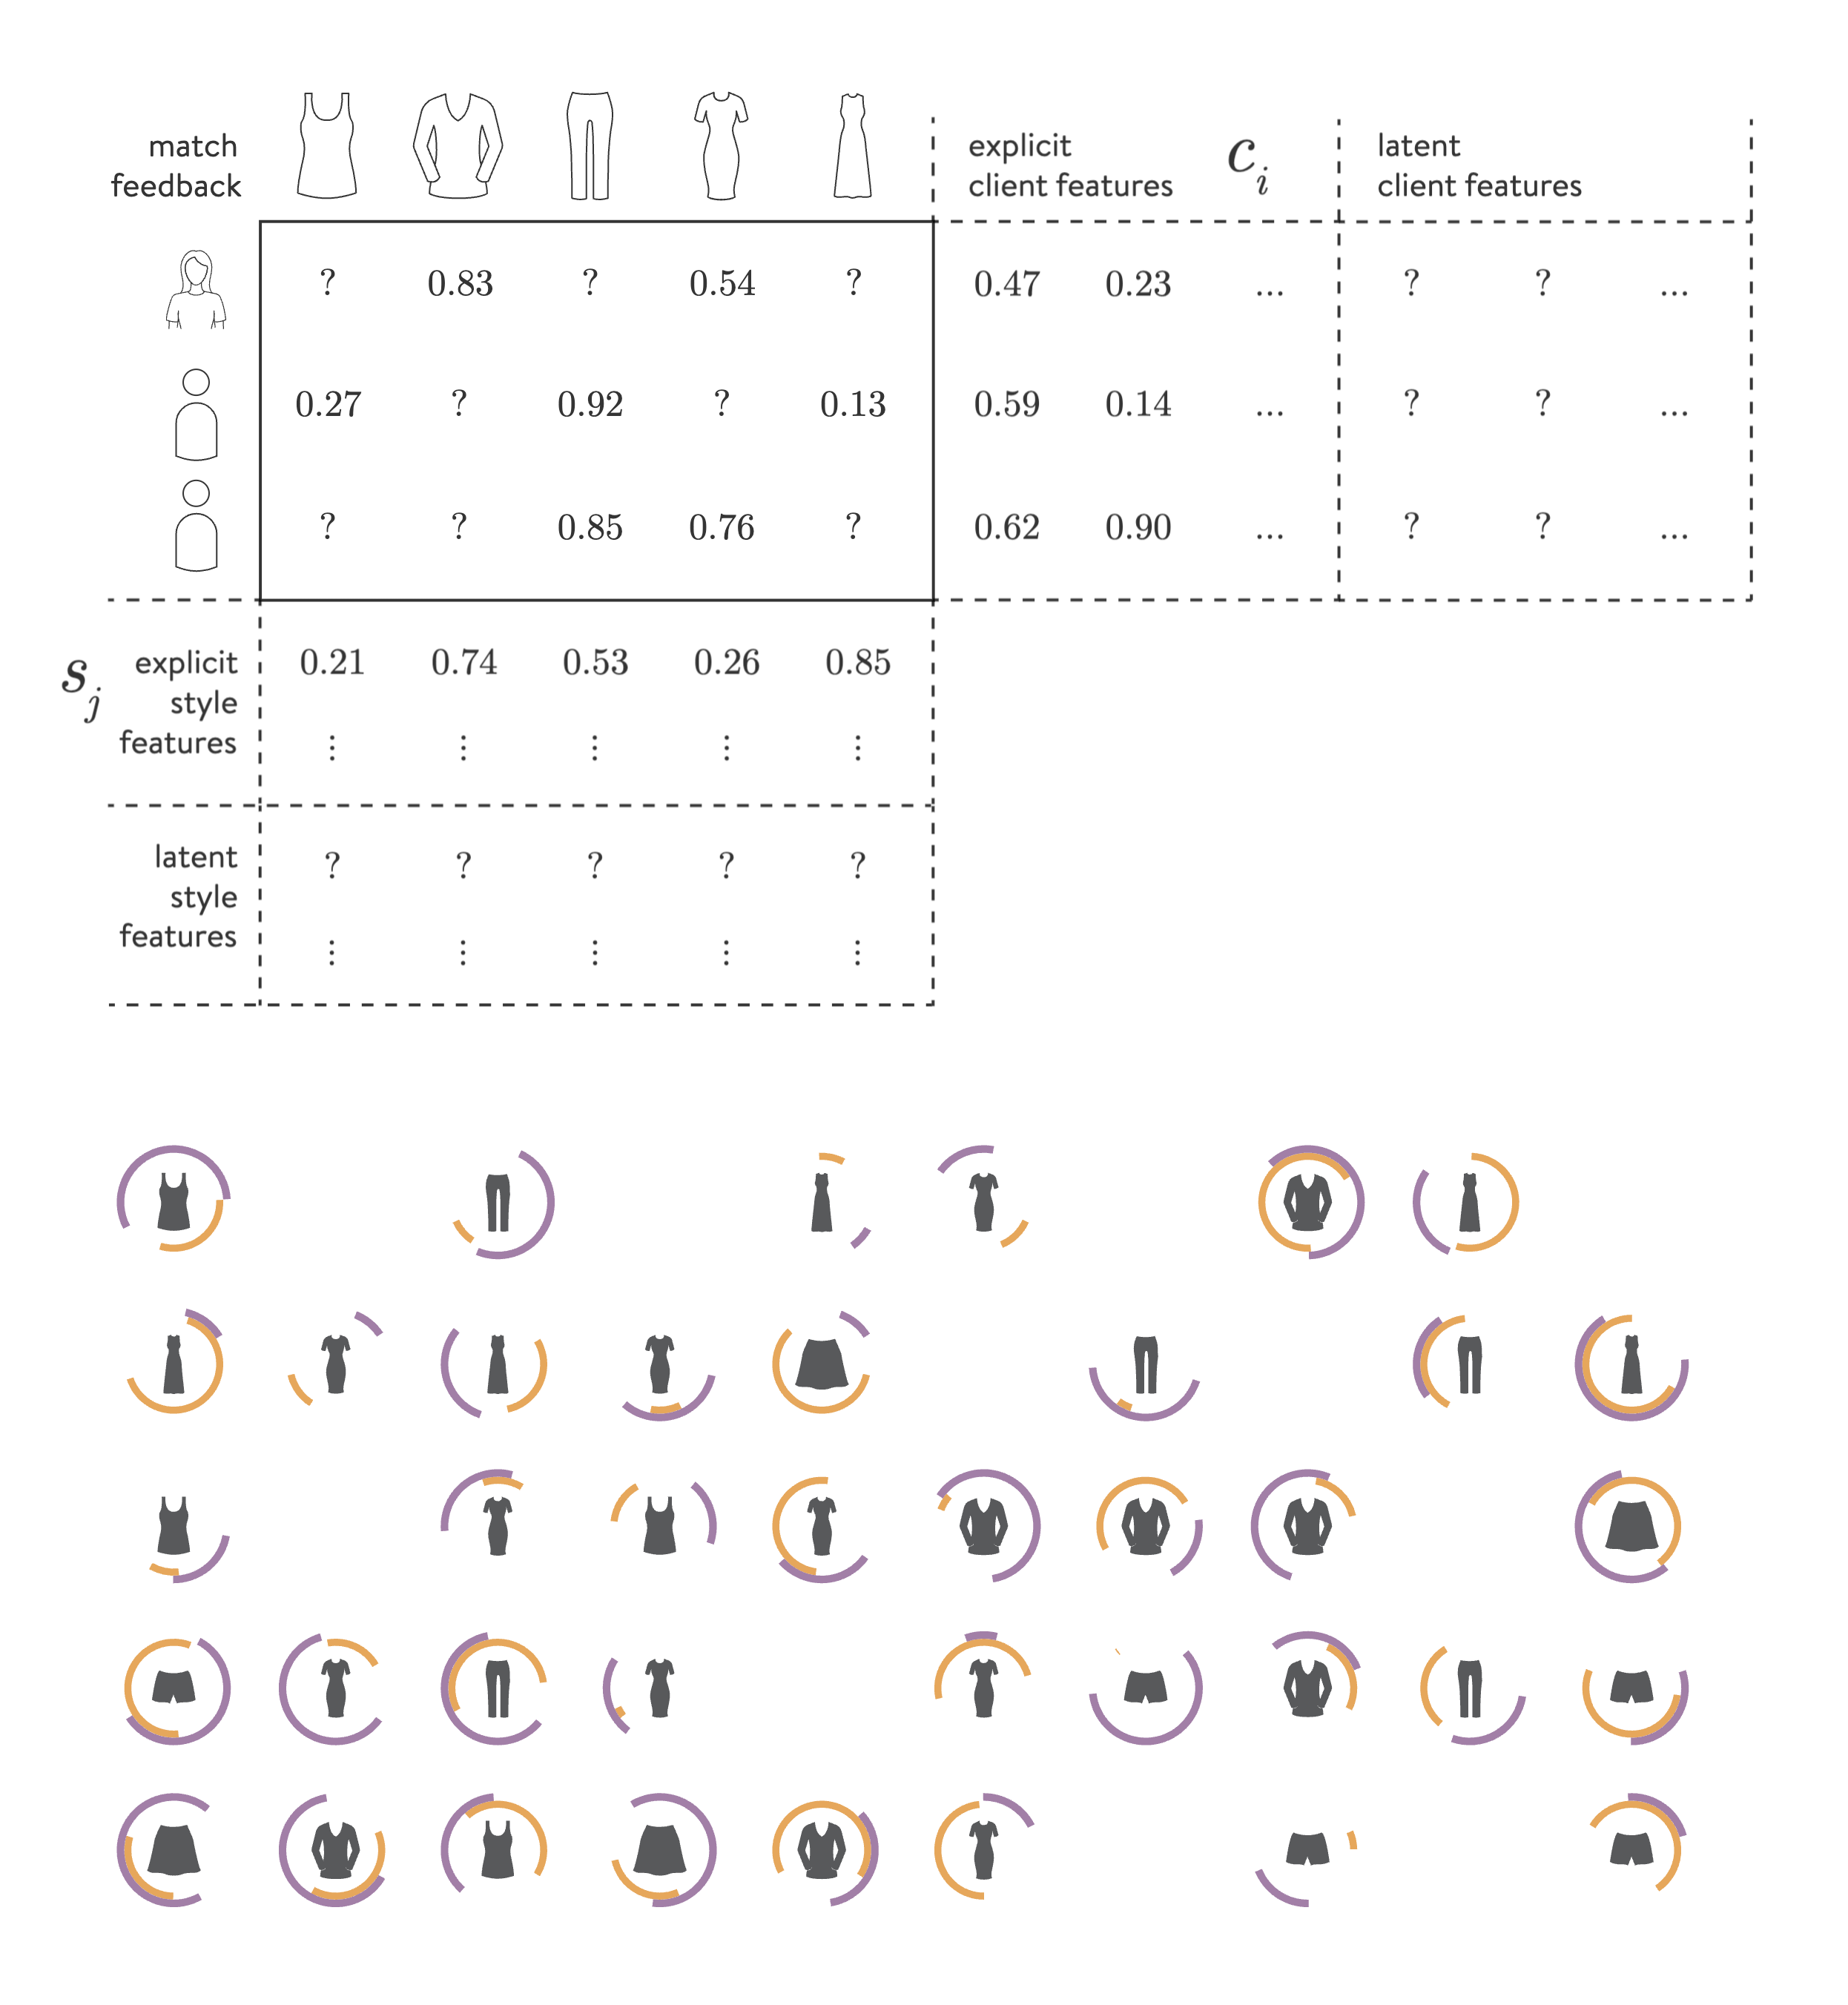
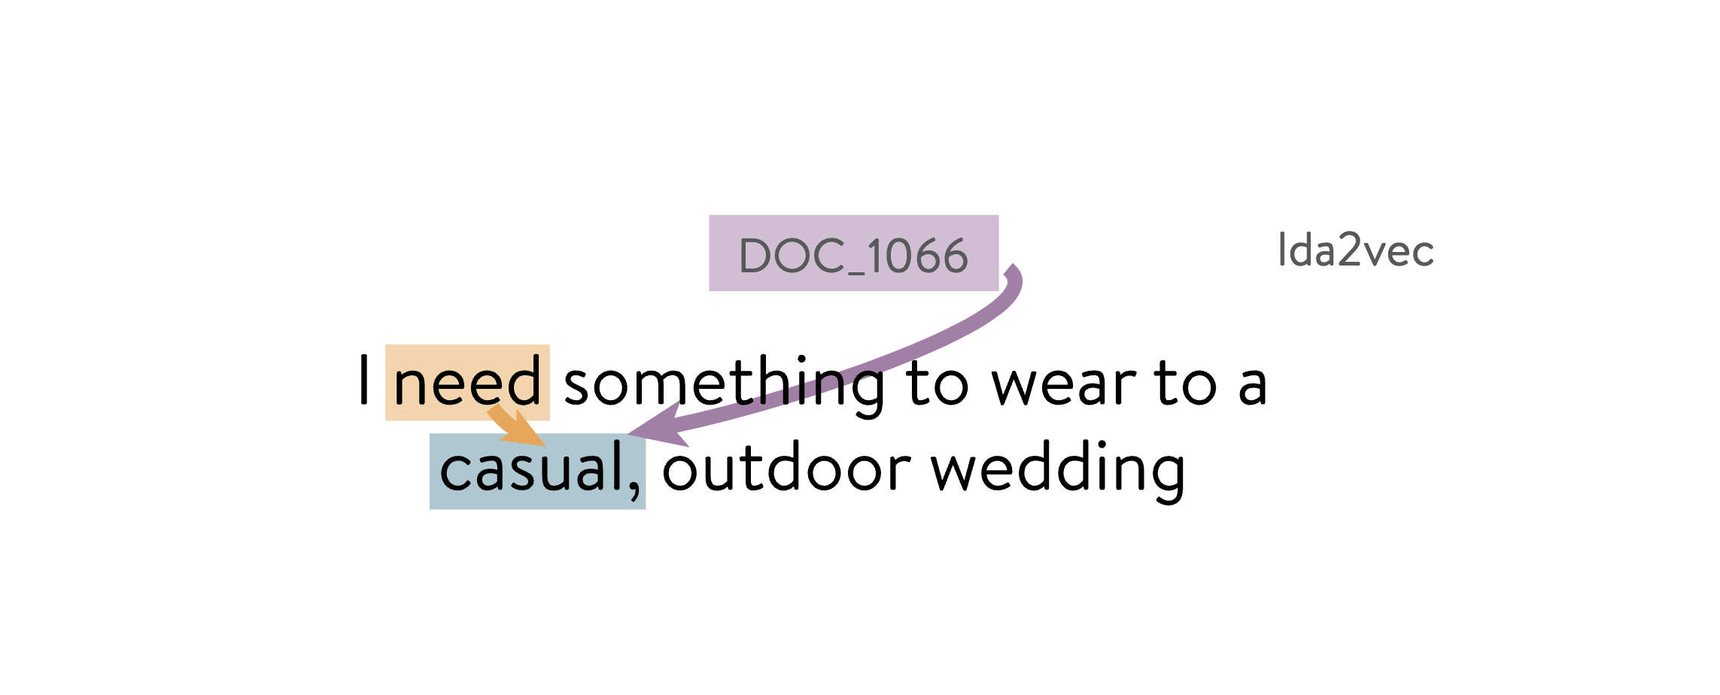
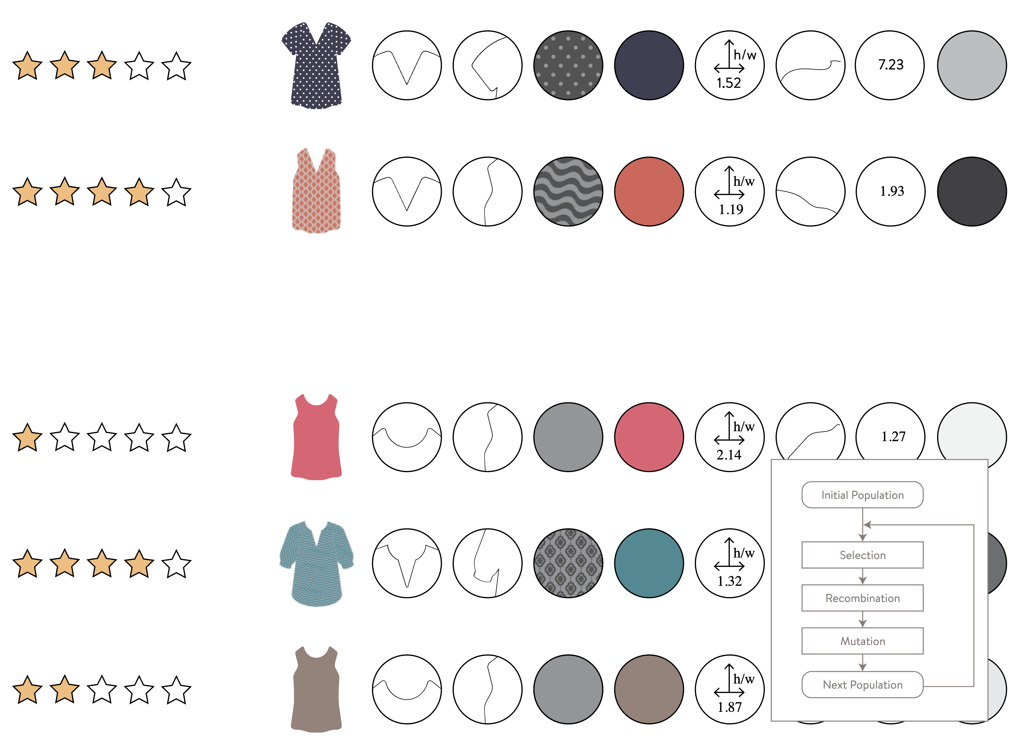
Machine learning IN ACTION

Slide 34
Machine learning IN ACTION

Slide 35
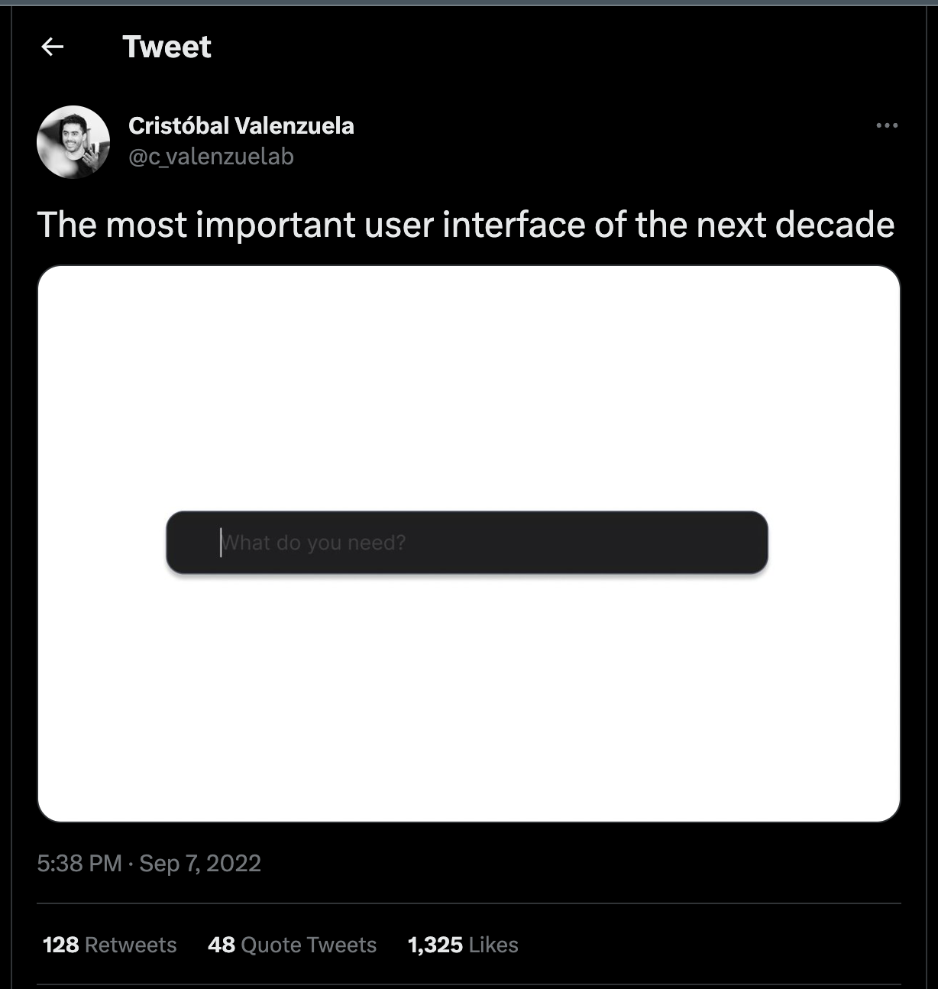
Prompt-driven design

Slide 36
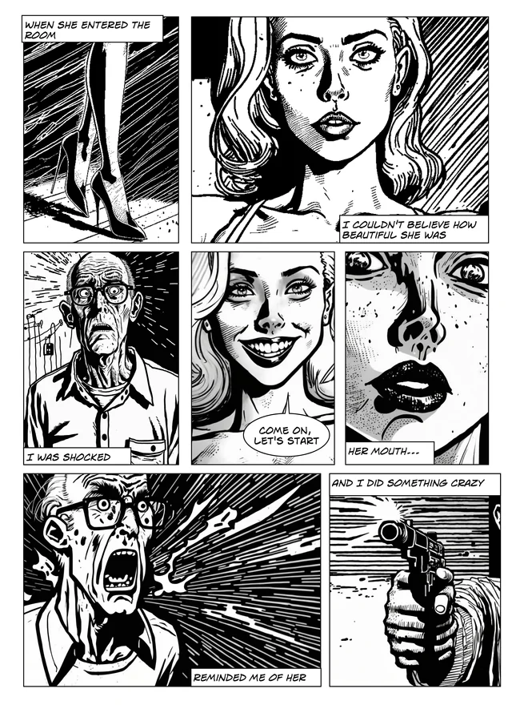
Generative ai

Slide 37
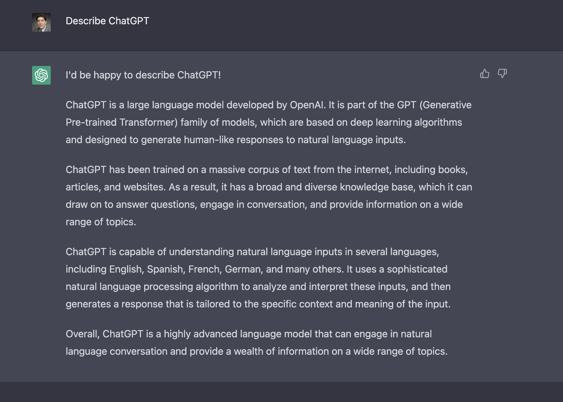
Generative AI Tools / CHATGPT

Slide 38
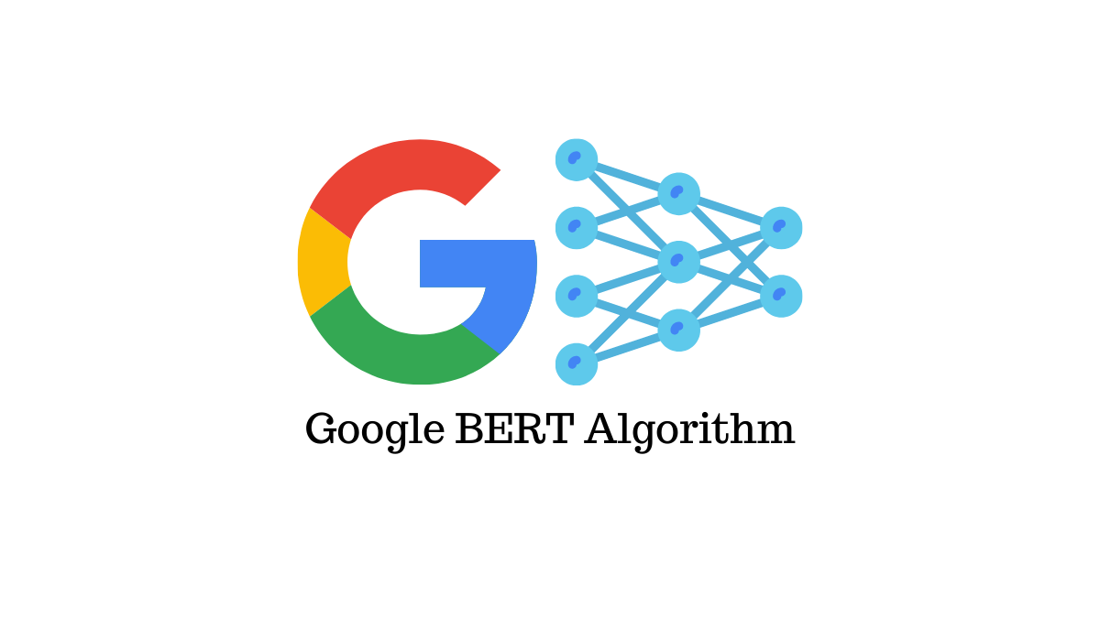

First text-based ml apps

Slide 39
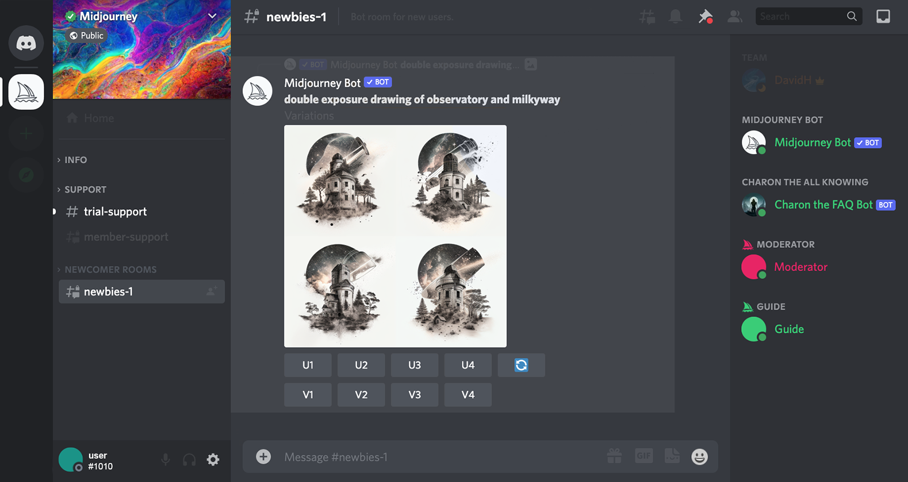
midjourney

Slide 40
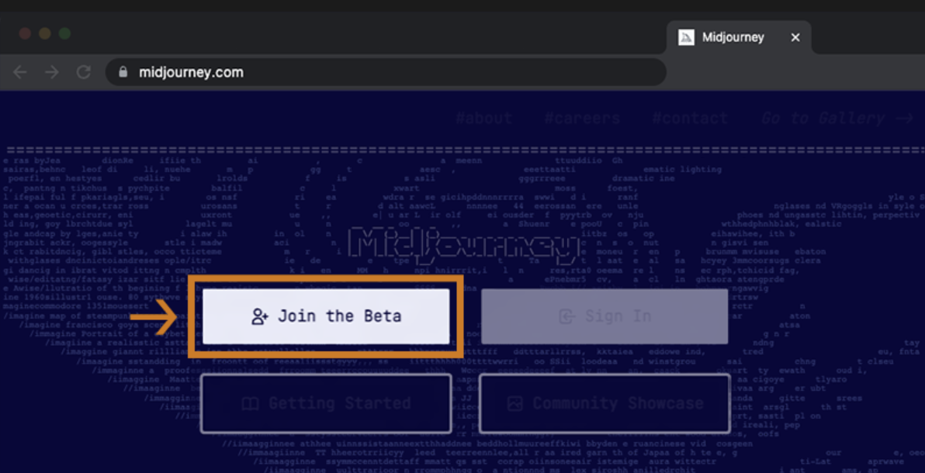
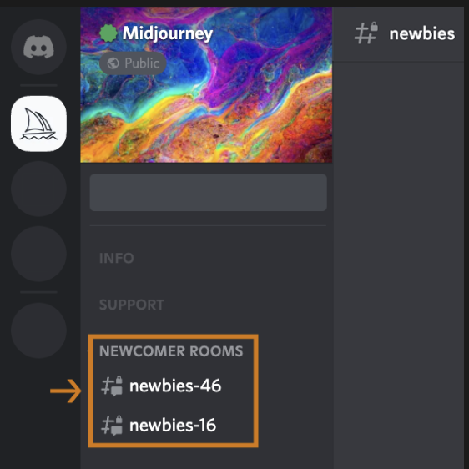
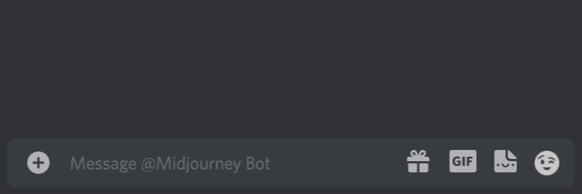
Midjourney quick START guide
1
2
3

Slide 41
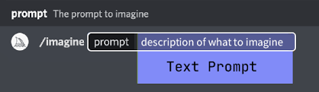
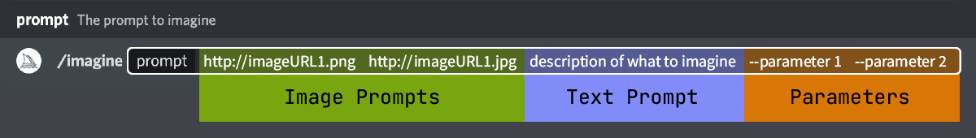
Midjourney prompt
2

Slide 42
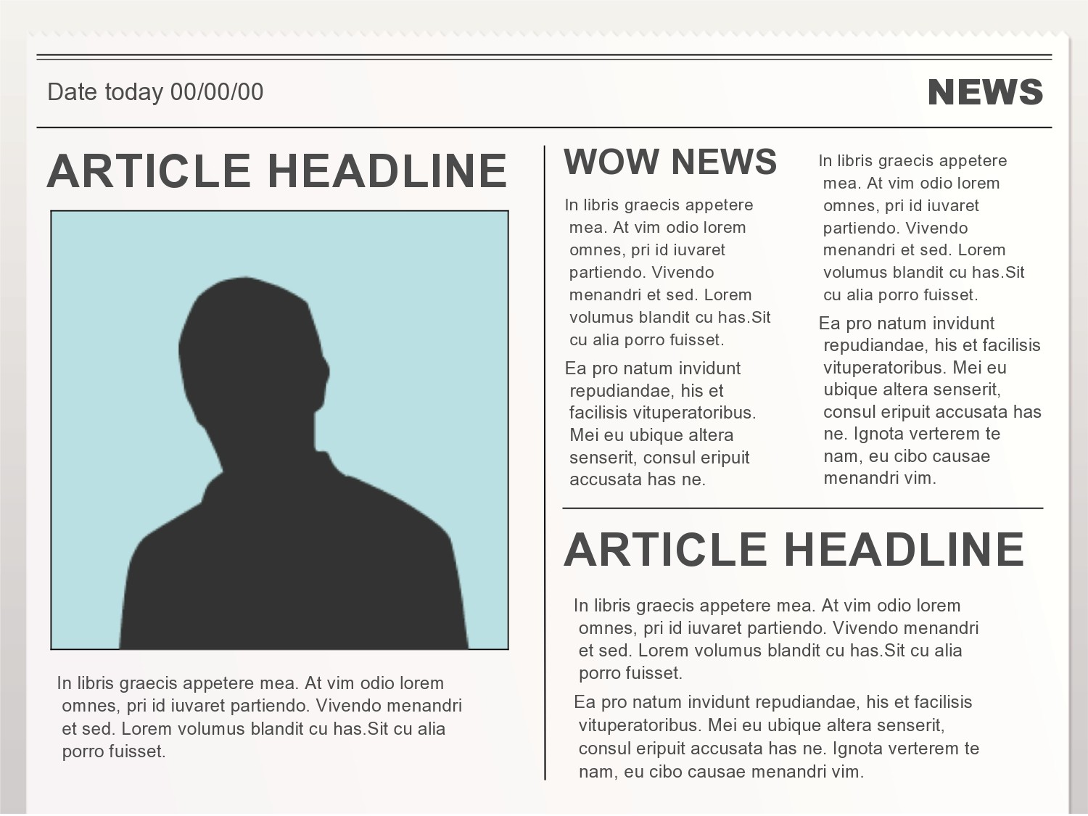
Midjourney examples

Slide 43
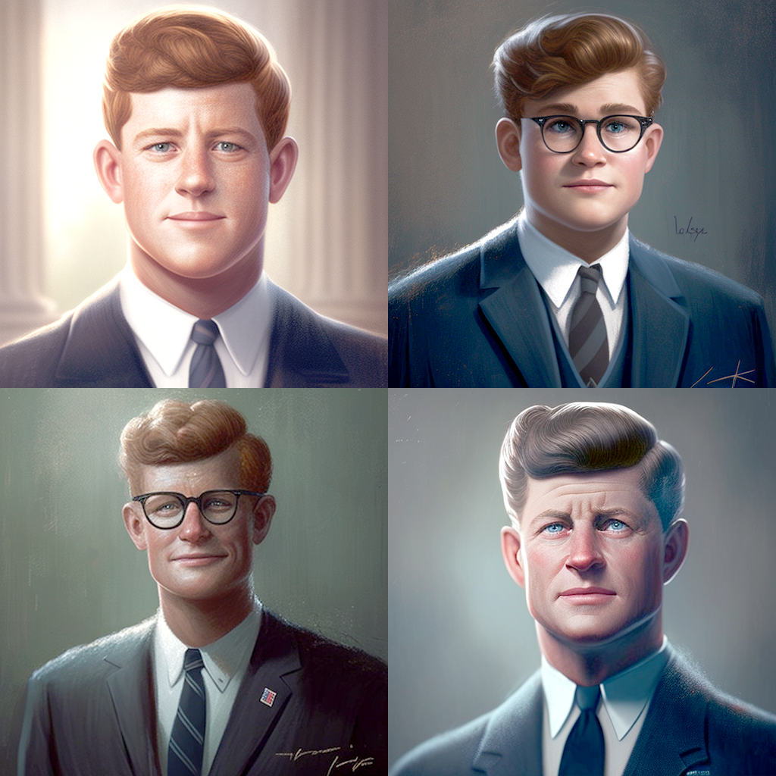
Midjourney examples
/imagine
President Kennedy realistic Pixar character -- ar 1:1

Slide 44
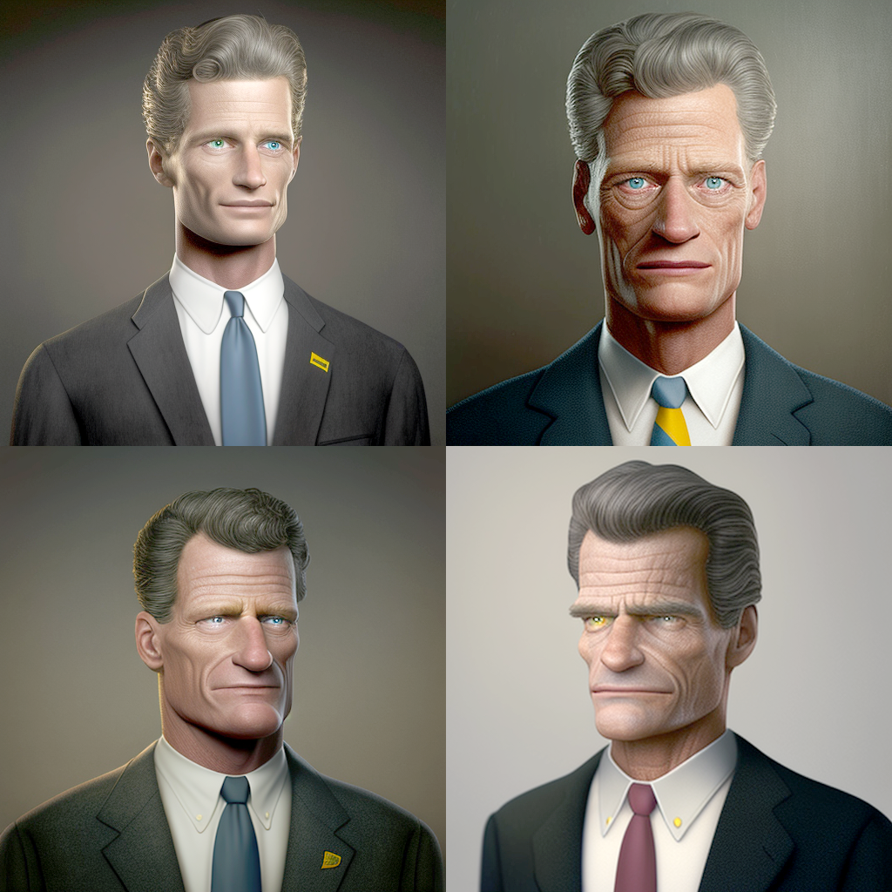
Midjourney examples
/imagine
President Kennedy realistic Simpsons character -- ar 1:1

Slide 45
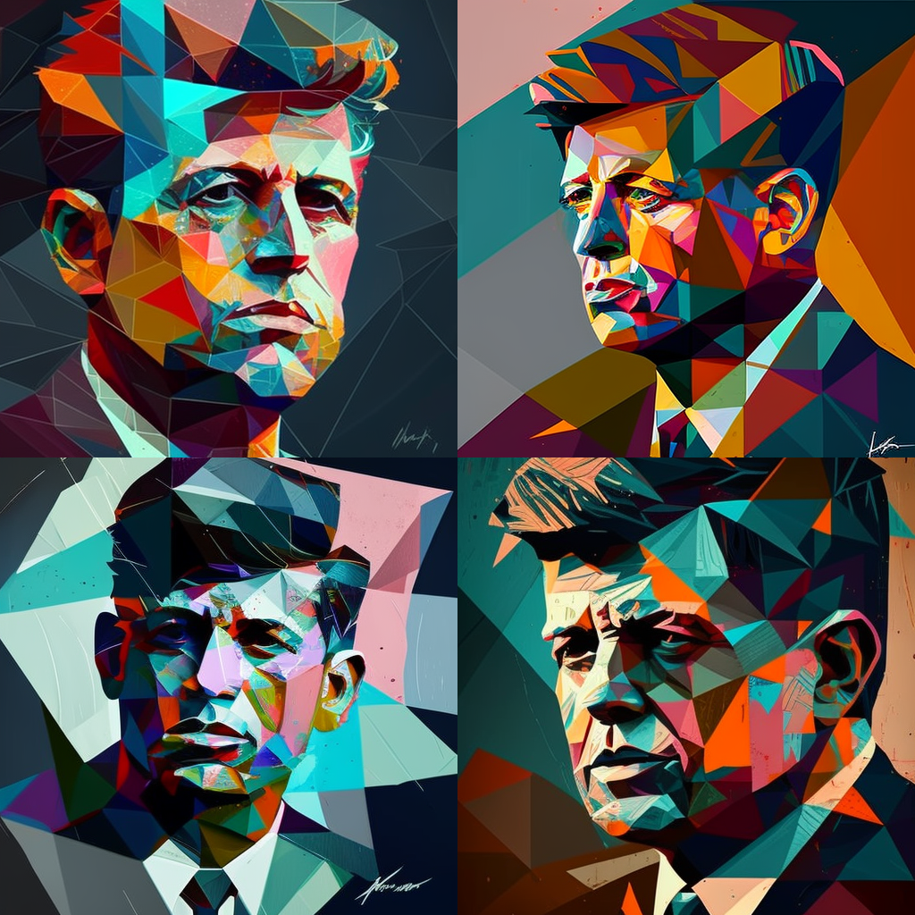
Midjourney examples
/imagine
President Kennedy Cubism style high vibrance -- ar 1:1

Slide 46
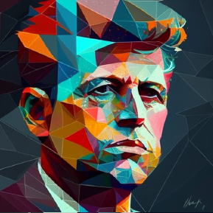
Midjourney examples

Slide 47
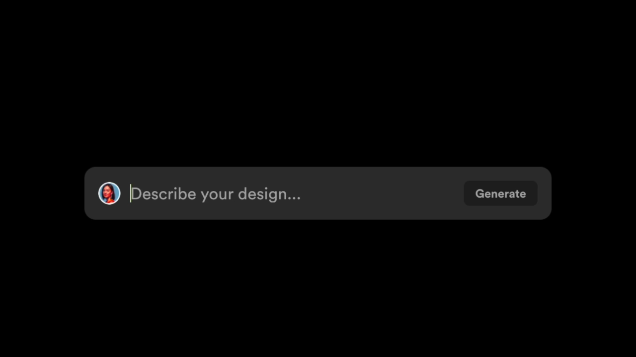
The future of design? Galileo ai

Slide 48
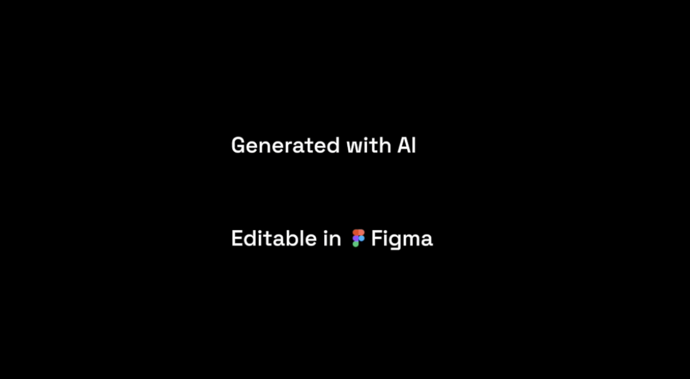
The future of design? Galileo ai

Slide 49
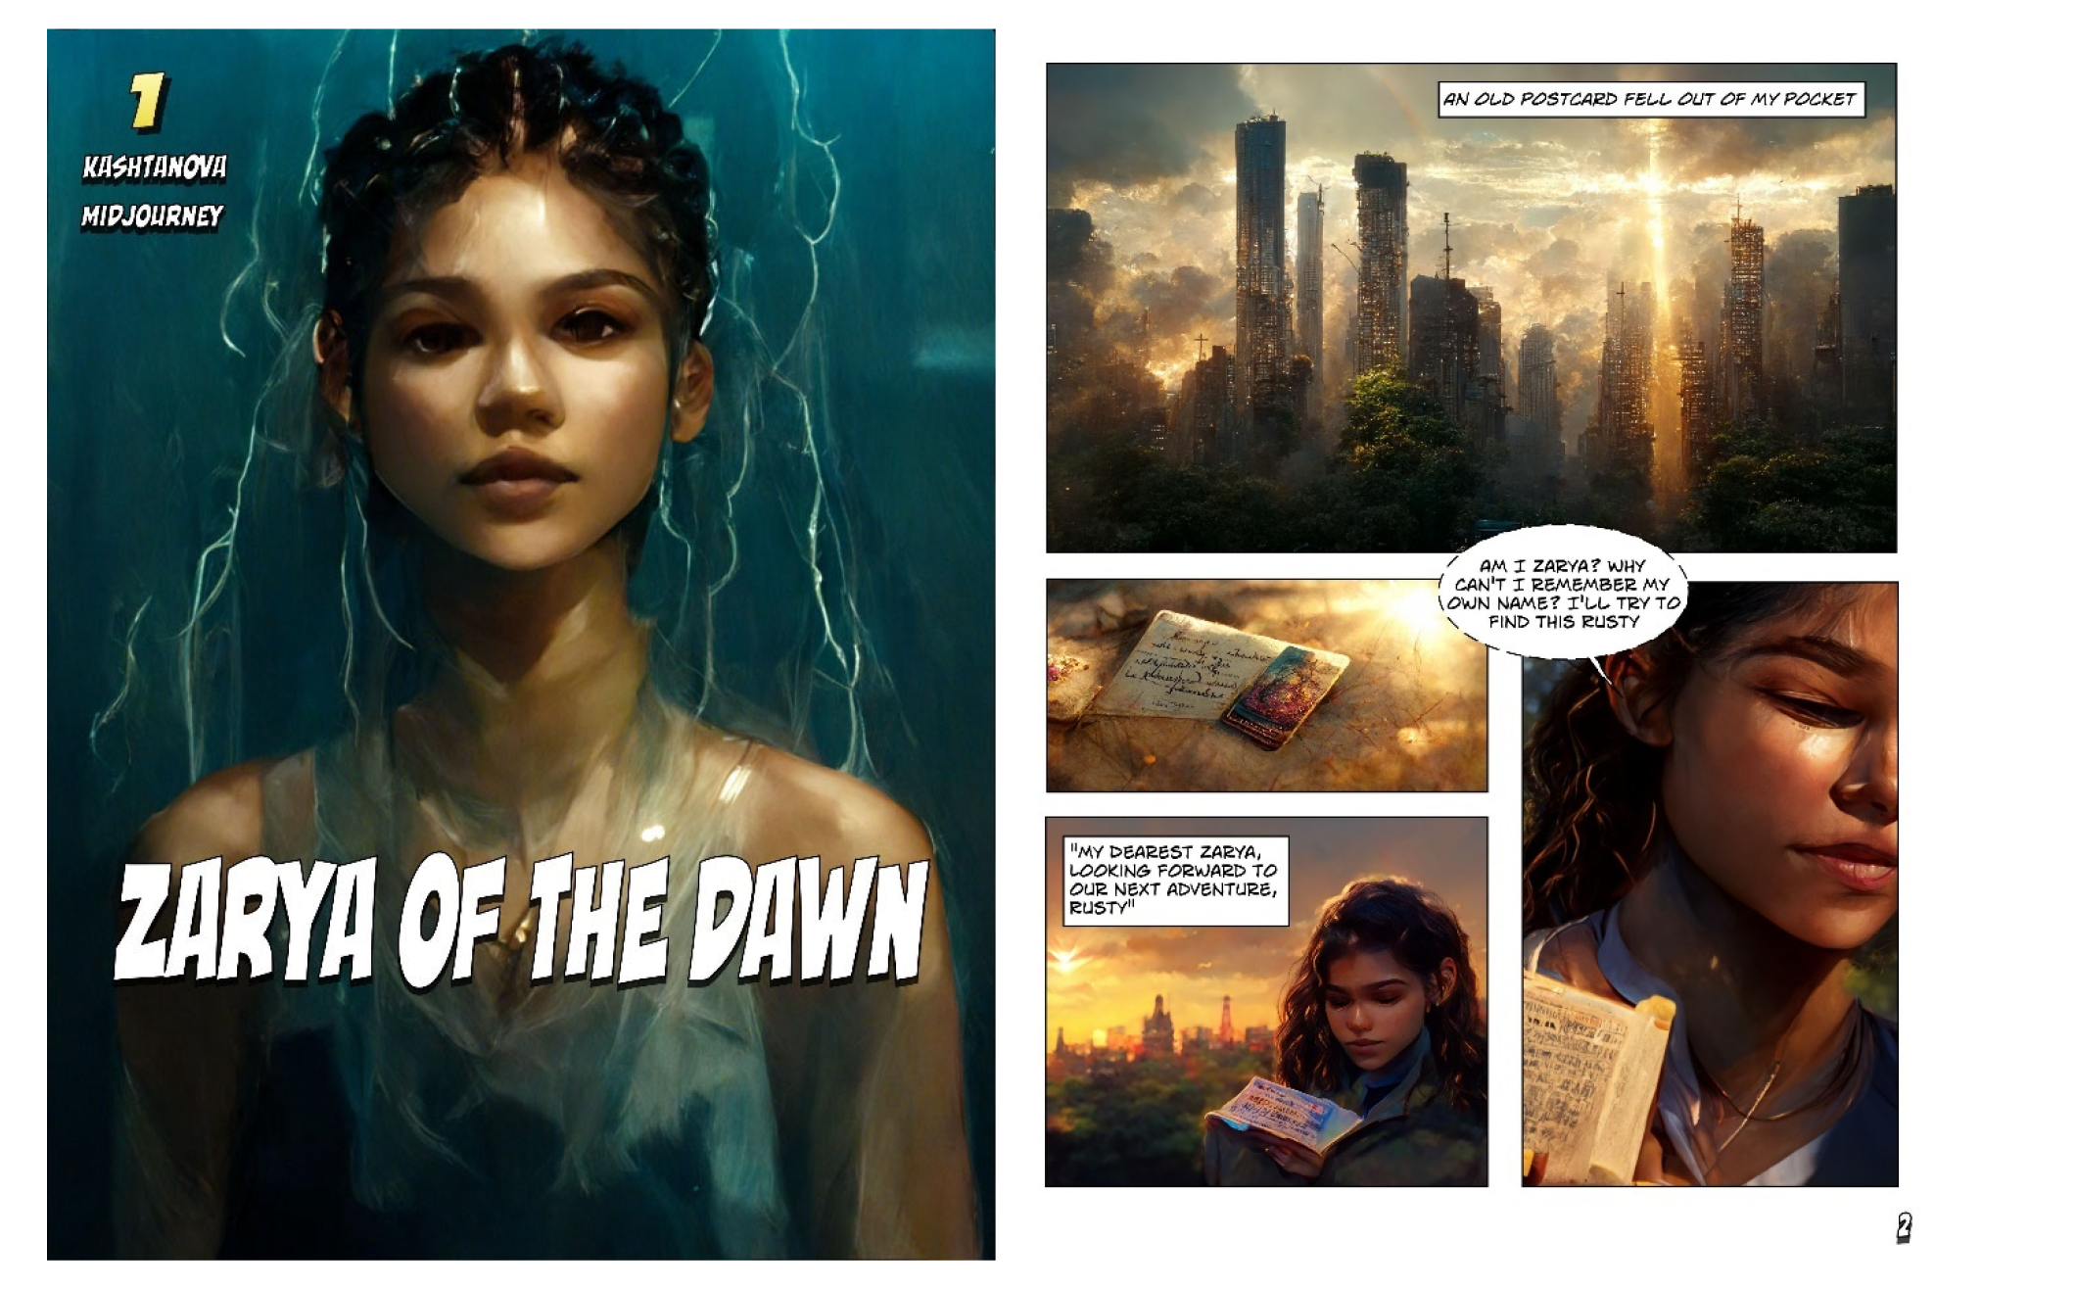
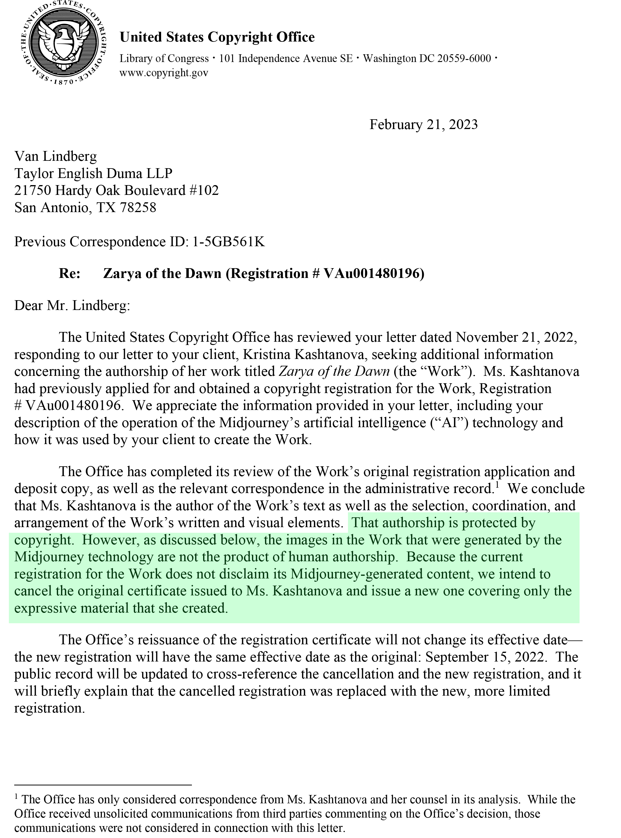
IS AI Stealing from artists?

Slide 50
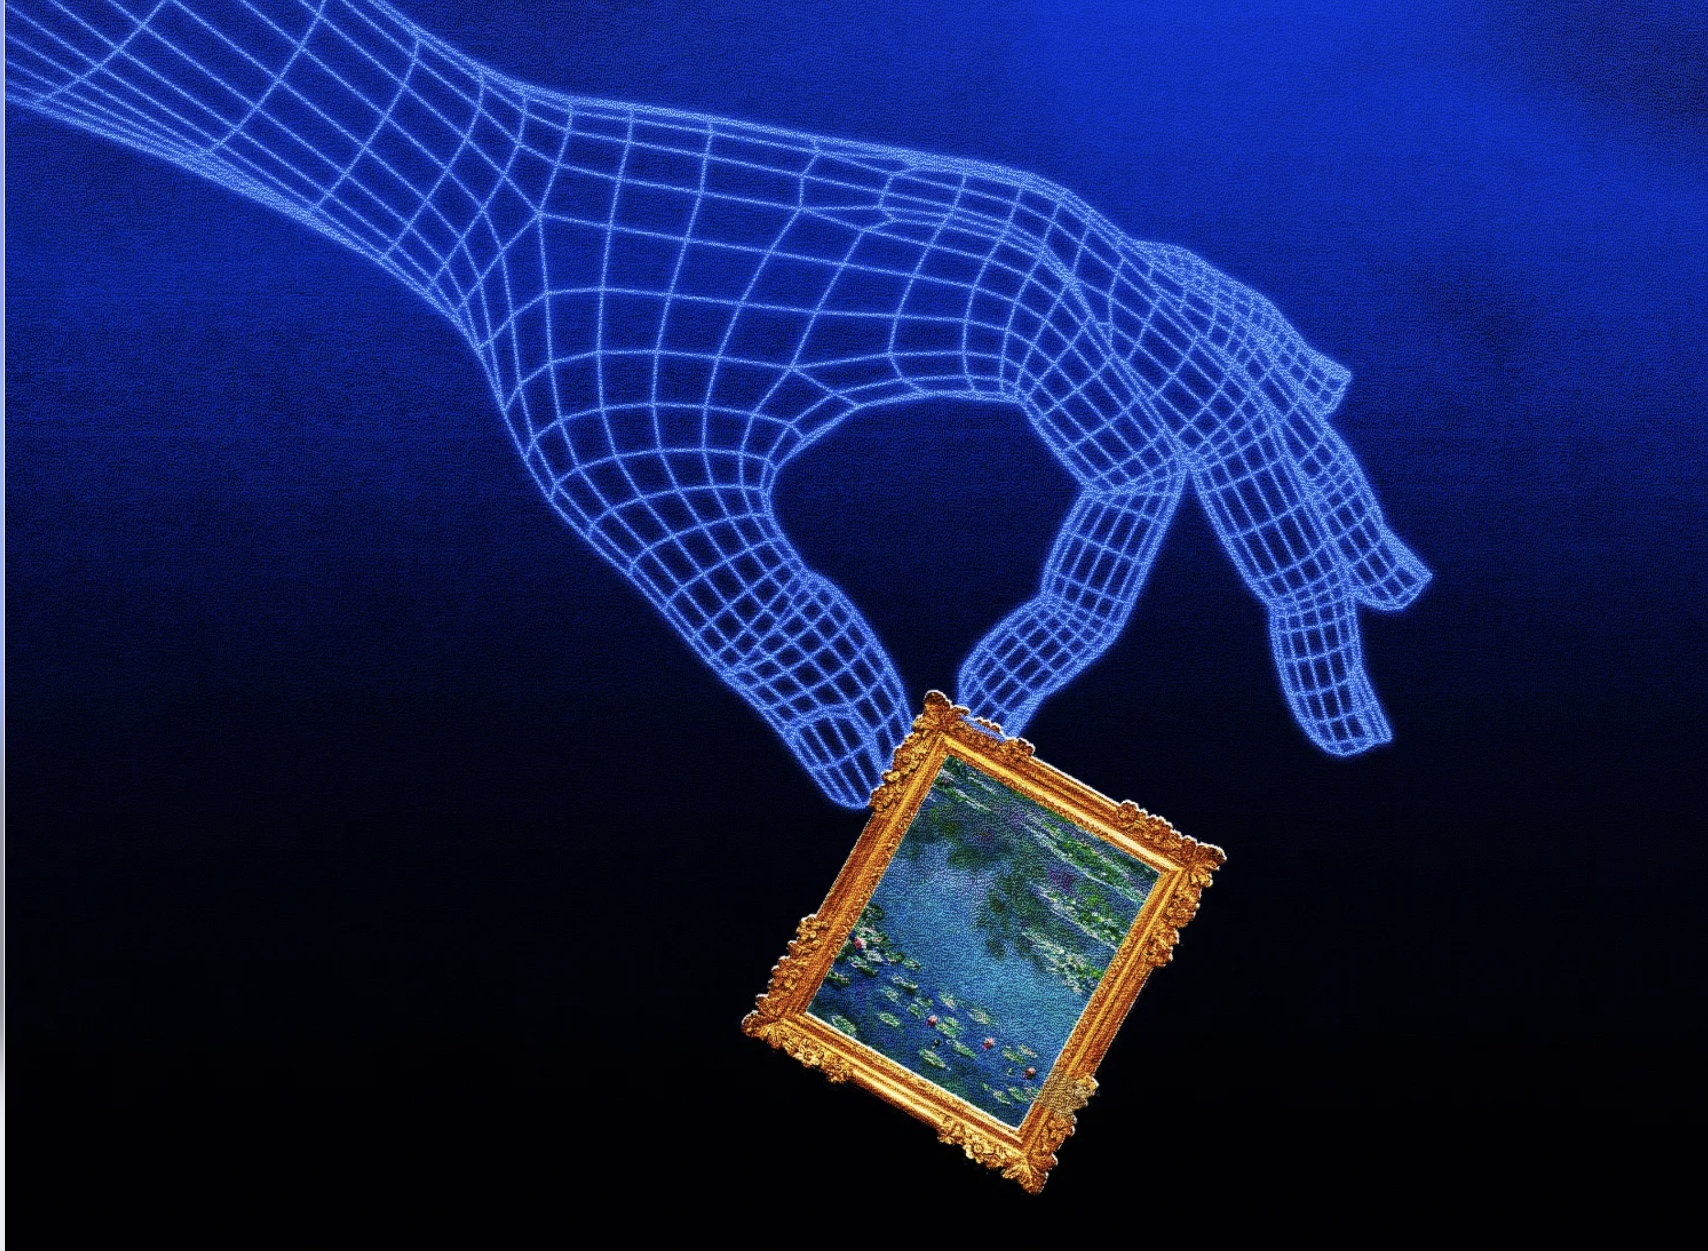
Who owns the future?
1
Consent
2
Compensation
3
Credit

Slide 51
Learn More
https://chat.openai.com/
https://www.midjourney.com/
https://stablediffusionweb.com/
https://galileo.ai
https://www.deeplearning.ai/

